Slide 1
PDF ANALYSIS WITH PYTHON

Slide 2
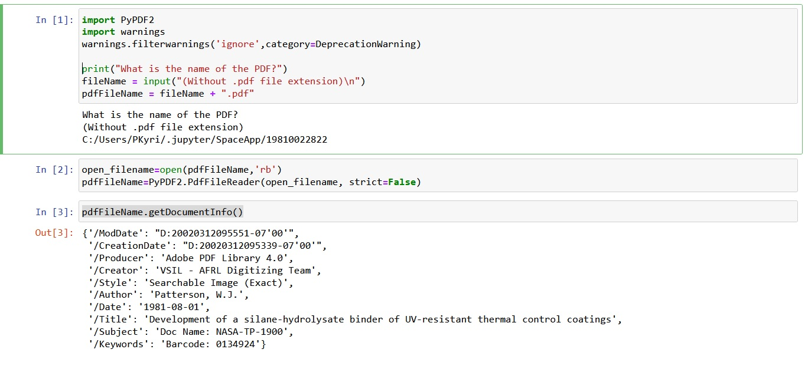
Extracting document information:

Slide 3
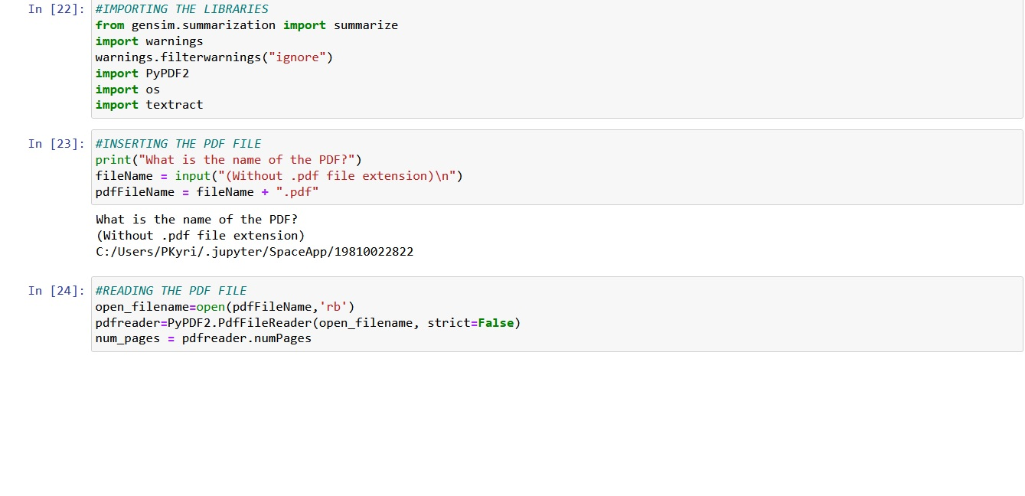
Summarize a pdf document:

Slide 4
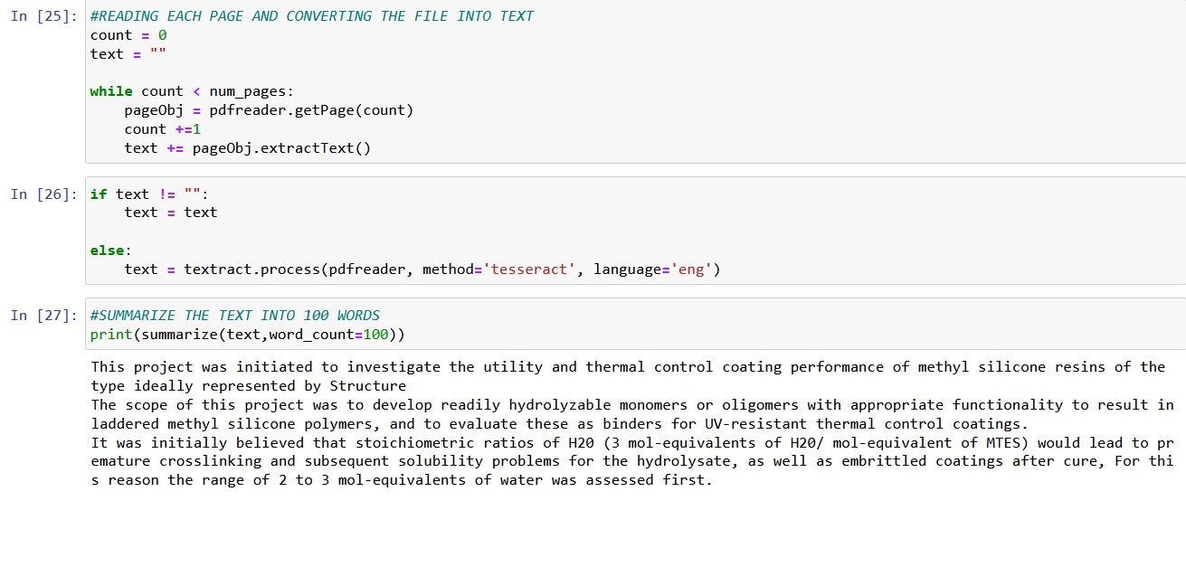

Slide 5
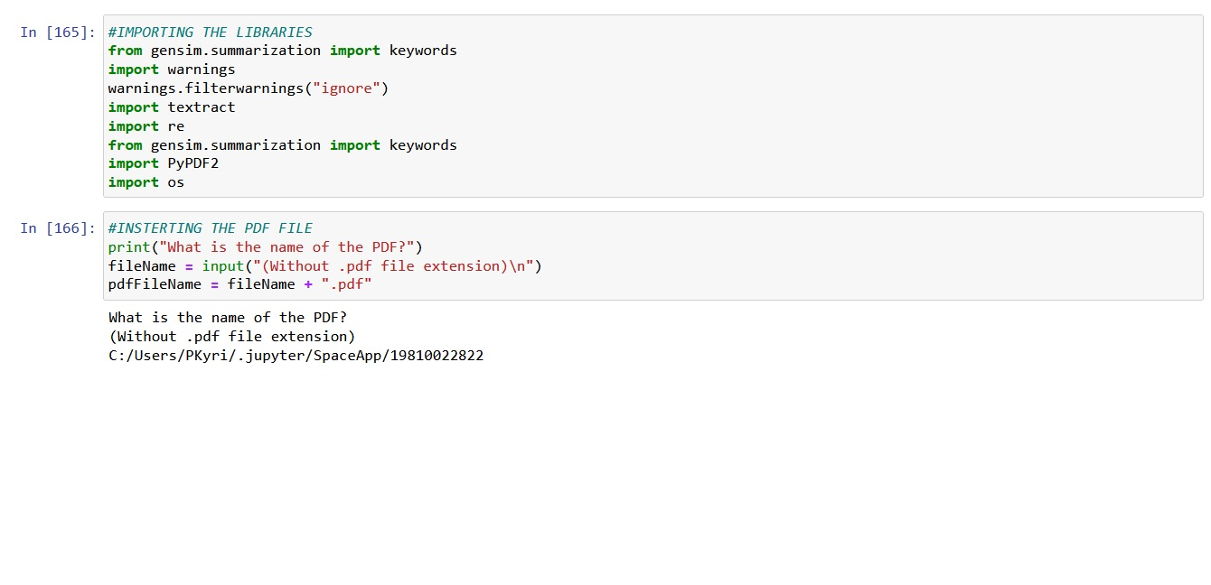
Extracting keywords

Slide 6
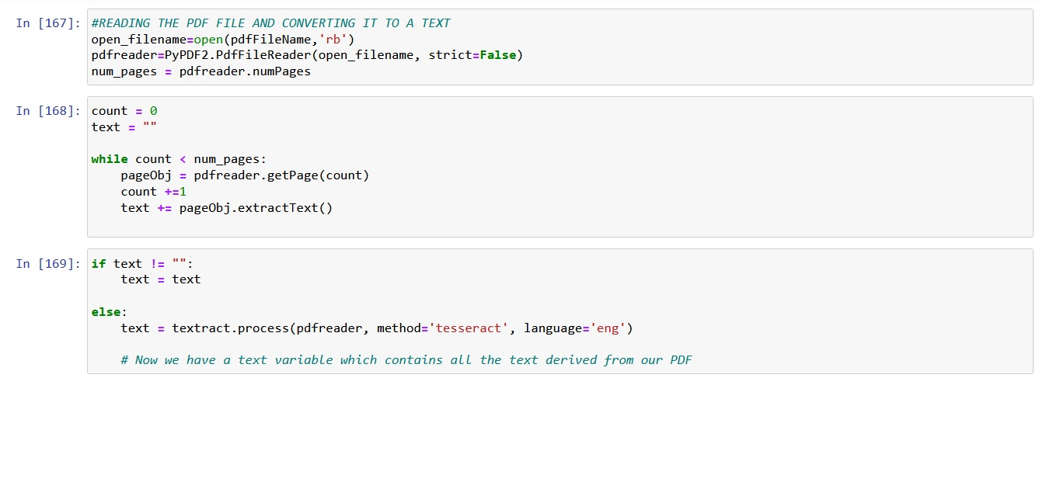

Slide 7
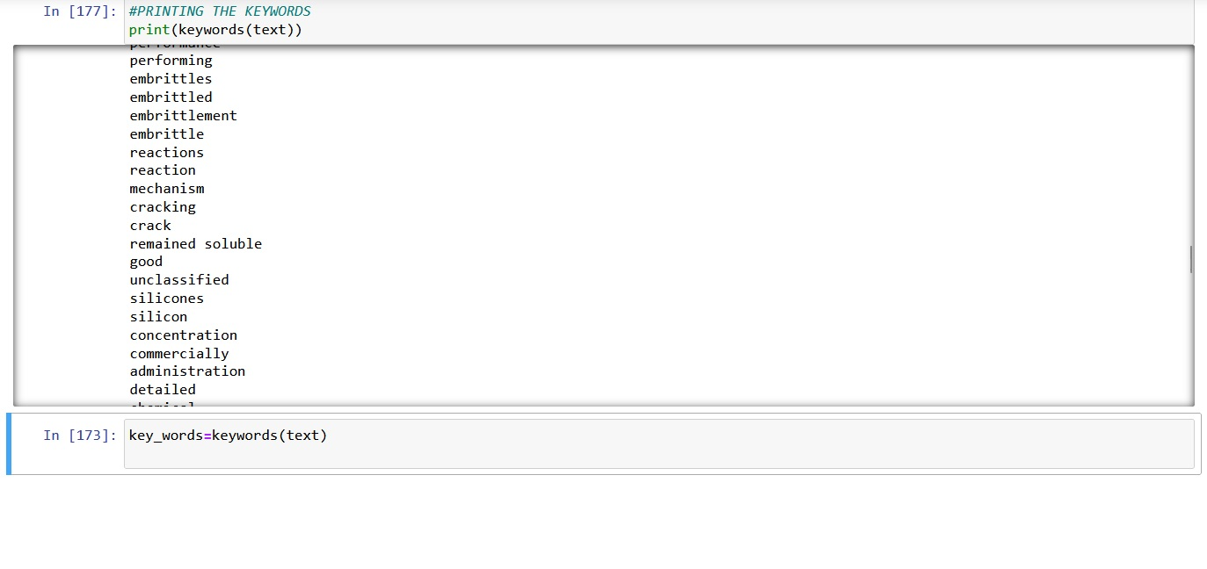

Slide 8
